Slide 1

Python Course (Final Project)
Engineer: Marko Nasef

Slide 2
5000 Movies Project

Slide 3
Q1: Open Your CSV file and print the first 10 rows in a good format
1- import the file
data = pd.read_csv("tmdb_5000_movies.csv")
2- Print the first 10 rows
data.head(10)

Slide 4
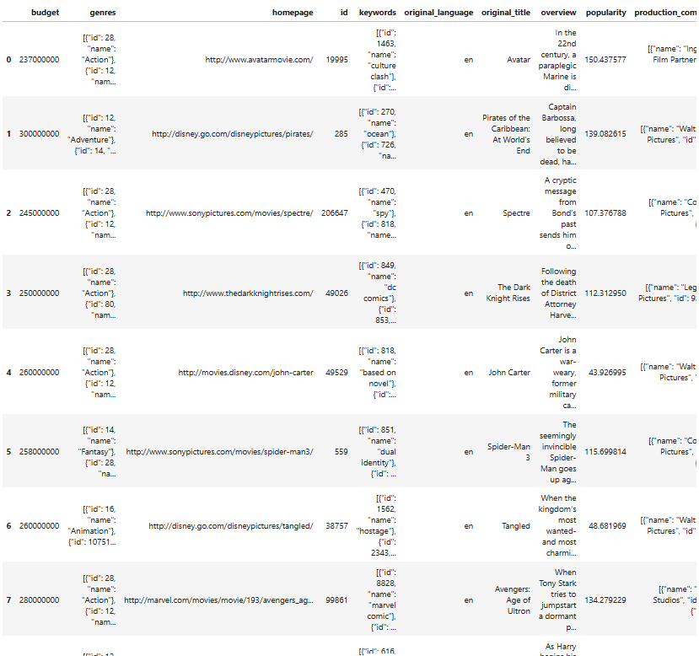

Slide 5
Step | Purpose | Code Example
Read the data (head, info) | Initial look at the shape and structure of data | df.head(), df.info()
Check column data types | Ensure correct data types for accurate analysis | df.dtypes
Handle missing values | Avoid issues or misleading results during analysis | df.isna().sum(), df.dropna(), df.fillna()
Clean unusual values (e.g., JSON) | Convert stringified lists/dictionaries to real Python objects | import ast df['column’] = df['column'].apply(lambda x: ast.literal_eval(x))
Review distribution & unique values | Understand data frequency and variation | df['column'].value_counts(), df.describe()
Fix incorrect or extreme values | Fix incorrect or extreme values | df = df[df['column'] > 0], df.boxplot(column='column')

Slide 6
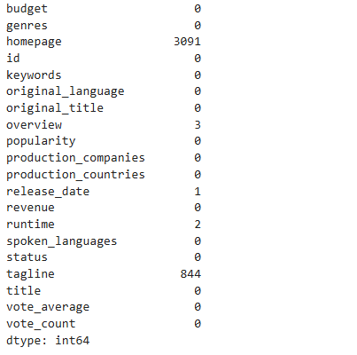
# Q2: Check if any NANs in your dataset and fill them with a good filer
Check the NAN Values
data.isna().sum()
#sum will get data per column without it will give me the whole sheet
2. Replace the NAN values with the word “Missing”
data.replace(np.nan , "Missing" , inplace = True)

Slide 7
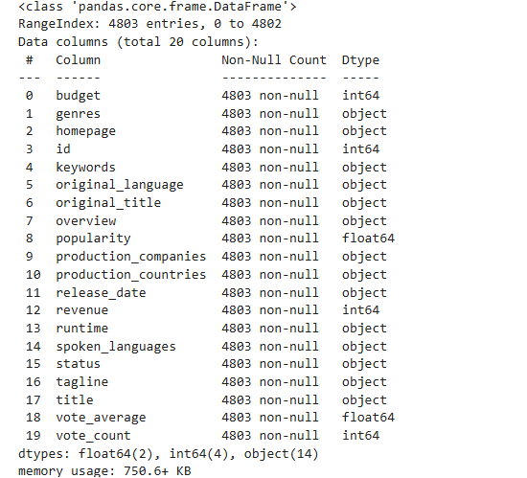
# Q3 : Discover the types of each columns and modify them if needed
Check the dataframe types
data.info ()
Get the column names to do the needed changes
data.columns
Convert 'release_date' to datetime format
data['release_date'] = pd.to_datetime(data['release_date'], errors='coerce’)
Convert runtime to numeric (non-numeric values will become NaN)
data['runtime'] = pd.to_numeric(data['runtime'], errors='coerce')

Slide 8
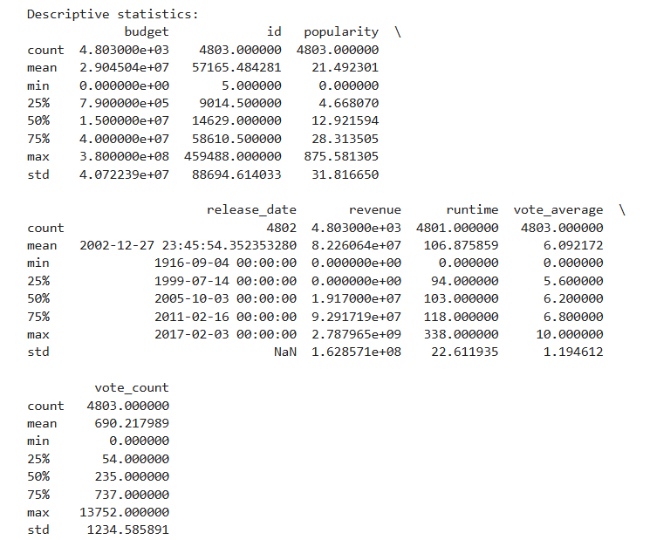
# Q4: Give a very simple statistical analysis for the numerical columns
print("\nDescriptive statistics:")
print(data.describe())

Slide 9
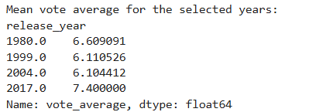
# Q5: Calculate the mean rate for [1999, 1980, 2004, 2017] the movies grouped by years
1- get the year from release_date
data['release_year'] = data['release_date'].dt.year
2- save it in new column release_year
3- select the targeted years
target_years = [1999, 1980, 2004, 2017]
4- filter the data an choose only from selected years
filtered_data = data[data['release_year'].isin(target_years)]
5- Make group for the years and then calculate the average
mean_vote_by_year = filtered_data.groupby('release_year')['vote_average'].mean()
6- Show result

Slide 10
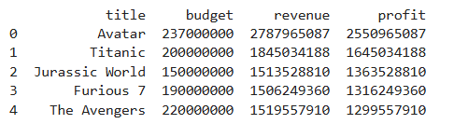
# Q6: Rearrange the dataframe based on revenue - budget values
1- Pandas imported
2- File loaded
3- calculate the profit = revenue – budget and put the value in new column named Profit
data['profit'] = data['revenue'] - data['budget’]
2- sort the movies from the highest to the lowest
data_sorted_by_profit = data.sort_values(by='profit', ascending=False)
3- clear the old index
data_sorted_by_profit = data_sorted_by_profit.reset_index(drop=True)
4- show the first five with the columns title, budget, revenue and profit
print(data_sorted_by_profit[['title', 'budget', 'revenue', 'profit']].head())

Slide 11
# Q7: Allocate the year with the largest movies released in ['Action', 'Romance’]
1- File loaded
2- dates converted in Q3
3- Import ast to work with Jason data
import ast
4- Covert the data in genres in dictionary
data['genres'] = data['genres'].apply(lambda x: ast.literal_eval(x) if isinstance(x, str) else x)
5- get the genres name from each dictionary
data['genre_names'] = data['genres'].apply(lambda x: [d['name'] for d in x])
6- Select the wanted genres (Action & Romance)
action_romance = data[data['genre_names'].apply(lambda genres: 'Action' in genres or 'Romance' in genres)]
7- calculate how many movies released
year_counts = action_romance['release_year'].value_counts()
8- get Highest year with movies and the number of movies
top_year = year_counts.idxmax()
top_count = year_counts.max()
9- print the result
10- print chart for it
Notes:
ليه نستخدم ast.literal_eval() ؟
لأن القيم داخل الأعمدة مثل genres تكون عبارة عن نصوص تشبه القوائم أو القواميس، ومحتاجين نحولها إلى كائنات Python حقيقية (list/dict).
✅ ast.literal_eval() بيعمل ده بأمان بدون تنفيذ أكواد ضارة زي eval().
idxmax() = تجيب السنة اللي حصل فيها أعلى عدد أفلام.
max() = تجيب الرقم الفعلي (عدد الأفلام).

Slide 12
السطر | الوظيفة | التوضيح
plt.figure(figsize=(12, 6)) | تحديد حجم الرسم البياني | عرض = 12، ارتفاع = 6 وحدات
plt.bar(year_counts.index, year_counts.values, color='coral') | رسم أعمدة | يرسم عدد أفلام الأكشن أو الرومانسية لكل سنة، واللون "coral"
plt.xlabel('Release Year') | عنوان المحور X | يوضح أن المحور الأفقي يمثل سنة الإصدار
plt.ylabel('Number of Action or Romance Movies') | عنوان المحور Y | يوضح أن المحور الرأسي يمثل عدد الأفلام
plt.title("Number of Action or Romance Movies Released per Year") | عنوان الرسم | يشرح محتوى الرسم البياني بشكل عام
plt.grid(True, linestyle='--', alpha=0.6) | شبكة خلفية | خطوط متقطعة وخفيفة تساعد في قراءة البيانات بسهولة
plt.tight_layout() | ضبط التنسيق | يتأكد أن كل العناصر في الرسم واضحة ومفيش أي تداخل
plt.show() | عرض الرسم | يُظهر الرسم البياني النهائي على الشاشة

Slide 13
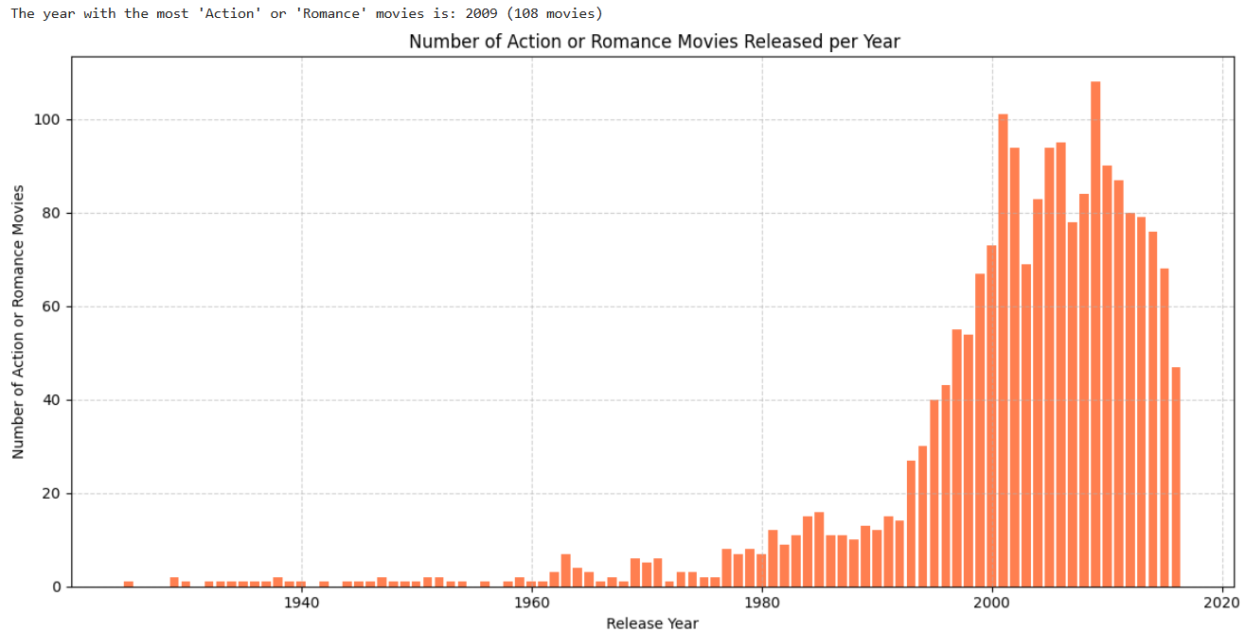

Slide 14
# Q8: Find the movies with top 5 revenue - budget value
1- sort by profit sorted_by_profit = data.sort_values(by='profit', ascending=False).reset_index(drop=True)
2- select first 5 movies
top_5_profitable_movies = sorted_by_profit[['title', 'budget', 'revenue', 'profit']].head(5)
3- Print result
4- Graph
Code | Function
plt.figure(figsize=(10, 6)) | يحدد حجم الرسم البياني
plt.barh(...) | يرسم مخطط أفقي للأرباح
[::-1] | يعكس الترتيب علشان يكون الأعلى في الأعلى بالرسم
color='green' | يخلي الأعمدة باللون الأخضر (يدل على الربح)
plt.xlabel("Profit (USD)") | عنوان المحور الأفقي
plt.title(...) | عنوان الرسم البياني
plt.tight_layout() | يظبط التباعد تلقائيًا
plt.show() | يعرض الرسم البياني

Slide 15
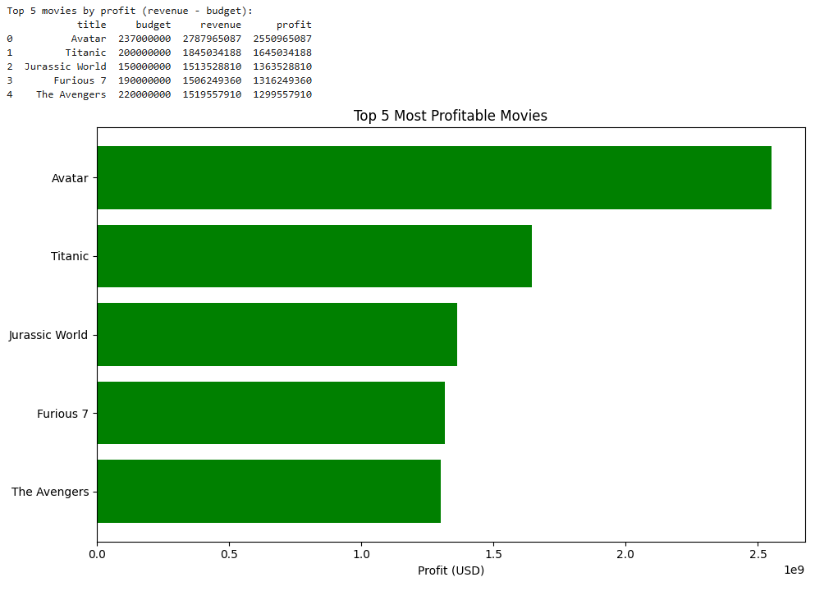

Slide 16
# Q9: Find the year with the highest number of movies release
1- Sheet already loaded
2- Dates already converted to data time
3- Count the movies in each year
movie_counts_per_year = data['release_year'].value_counts()
4- Get the year with the most movies
top_year = int(movie_counts_per_year.idxmax())
top_count = movie_counts_per_year.max()
5- Show result
6- Show the chart

Slide 17
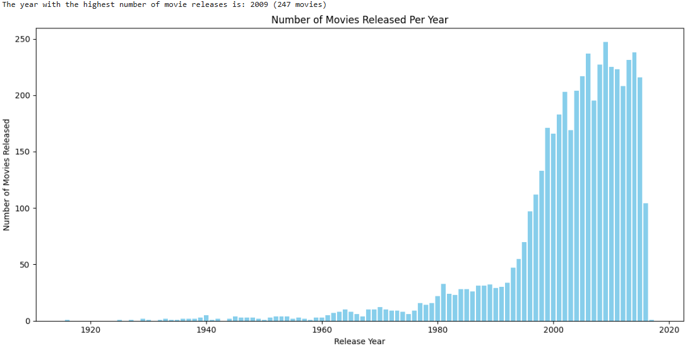

Slide 18
Q10 : Find the top 2 countries with the highest production movies number
1- We need to import counter to be able to count
from collections import Counter
2- instead of having Jason string data we will convert it to Dicationary
df['production_countries'] = df['production_countries'].apply(lambda x: eval(x) if isinstance(x, str) else [])
2- Get the country name from each list inside the Production_countries
df['country_names'] = df['production_countries'].apply(lambda x: [d['name'] for d in x if 'name' in d])
3- Check all the counties list that we have and check count the duplication
country_counter = Counter()
for country_list in df['country_names’]:
country_counter.update(country_list)
4- Print the most 2 courtiers with the most production
for country, count in country_counter.most_common(2):
print(f"{country}: {count} movies")
Notes:
lambda هي طريقة في بايثون نكتب بيها دالة (function) صغيرة وسريعة في سطر واحد بس، من غير ما نستخدم def.

Slide 19
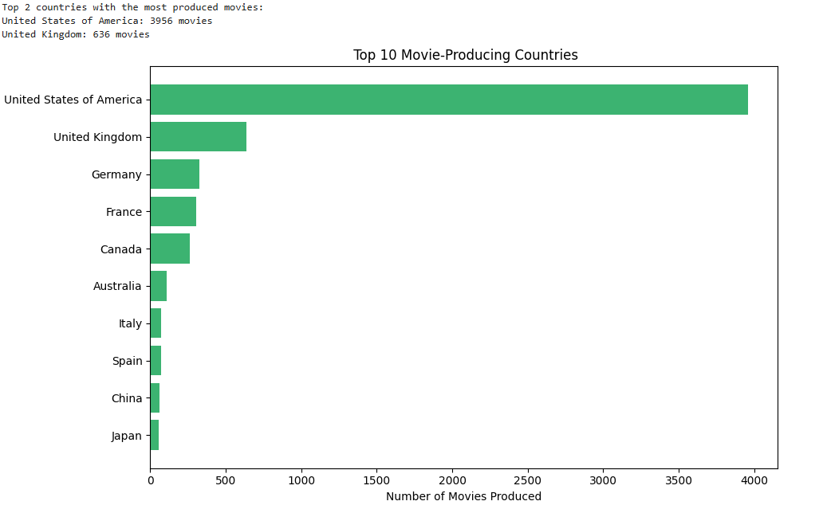

Slide 20
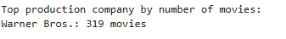
# Q11: Find the top 1 company with the highest production movies number
1- Convert production column to dictionary
data['production_companies'] = data['production_companies'].apply(lambda x: eval(x) if isinstance(x, str) else [])
2- Get company name from each row
data['company_names'] = data['production_companies'].apply(lambda x: [d['name'] for d in x if 'name' in d])
3- Count the movies for each company
company_counter = Counter()
for company_list in data['company_names']:
company_counter.update(company_list)
4- get the first company
top_1 = company_counter.most_common(1)
5- print result
print("Top production company by number of movies:")
for name, count in top_1:
print(f"{name}: {count} movies")

Slide 21
# Q12: Is there any relation between the runtime and average vote value
import pandas as pd
import matplotlib.pyplot as plt
Load the dataset
Convert columns to numeric types
Drop rows with missing values in the relevant columns
Calculate the correlation between runtime and average vote
Create a scatter plot to visualize the relationship

Slide 22
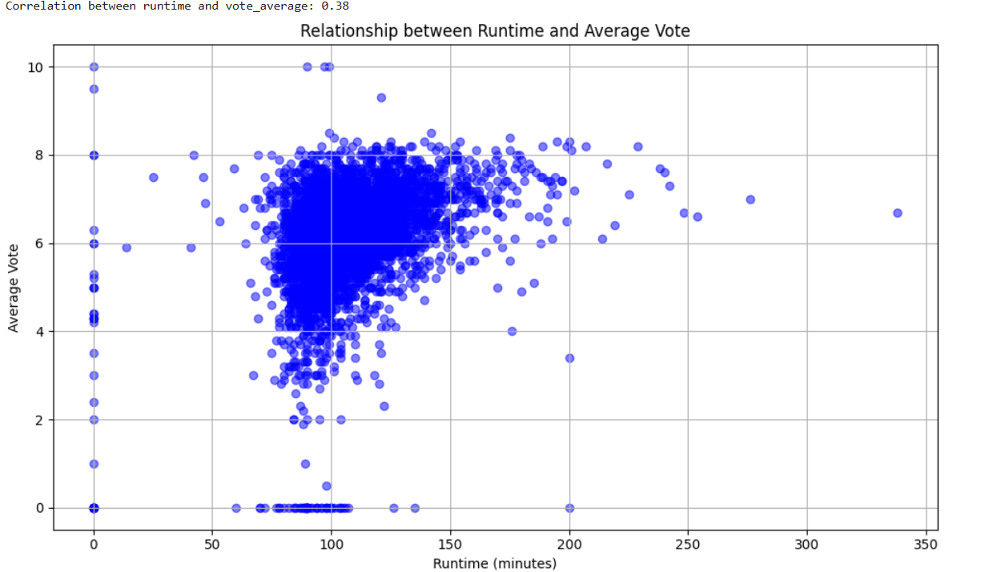

Slide 23
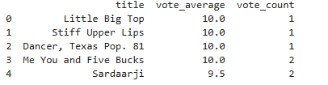
Q13: Find the top 5 movies with the highest rate, ?? and find if there anything common between them ??
1- Pandas imported
2- ast imported
3- Counter imported from collection
4- Genres already converted in Q7
5- production companies column already converted to python in Q 11
6- Company names already extracted in Q 11
7- Sort by vote_average in descending order and select the top 5
top_5_rated_movies = data.sort_values(by='vote_average', ascending=False)[['title', 'vote_average', 'vote_count']].head(5).reset_index(drop=True) #to remove the original file index from the results
8- Print result

Slide 24
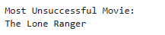
# Q14: Find the most unsuccessful movie along time in terms of revenue – budget
1- File already loaded
2- Pandas already imported
3- Make sure budget and revenue are numbers
4- calculate profit
5- get the movie with the lowest profit
6- Print result

Slide 25
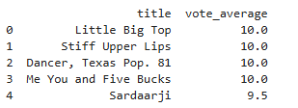
# Q 15: Rearrange the dataframe based on vote average column values
1- File already loaded
2- Pandas already imported
3- Make sure vote average are numbers
4- Sort the DataFrame by vote_average in descending order
5- Reset index
6- Print Result

Slide 26
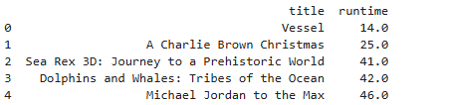
# Q16: Rearrange the dataframe based on runtime column values
1- Pandas imported
2- file uploaded
3- convert runtime to numbers
4- sort by runtime and must be > 0
5- show results

Slide 27
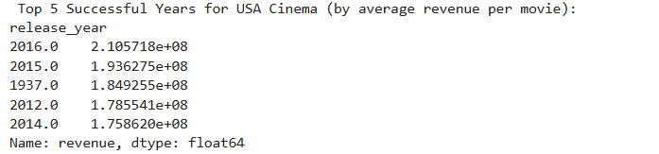
#Q17: Find the top 5 successful years for the USA cinema based on the total income devided by number of movies
import pandas as pd
import ast
Load the dataset
Convert release_date to datetime and extract year
Safely convert 'production_countries' column from string to list of dicts
Identify USA-produced movies using country code 'US’
Filter for USA movies with valid revenue and valid release year
Group by release year and calculate average revenue per movie
Sort to get the top 5 most successful years
Display the result

Slide 28
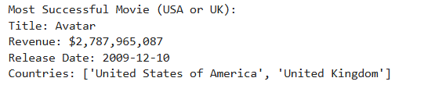
#Q18: Find the most succesfull movie in [USA, UK]
import pandas as pd
import ast
Load the dataset
Safely convert 'production_countries' from string to list of dictionaries
Define a function to check if movie was produced in USA or UK
Filter movies produced in USA or UK with valid revenue
Get the movie with the highest revenue
Display the result

Slide 29
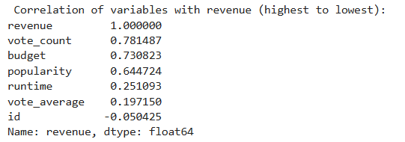
#Q19: In your opinion what is the highest variable that affects the revenue value (high coloration)
import pandas as pd
Load the dataset
Convert relevant columns to numeric
Drop rows with missing revenue
Calculate correlation of all numeric columns with revenue
Display the result

Slide 30


